Slide 1
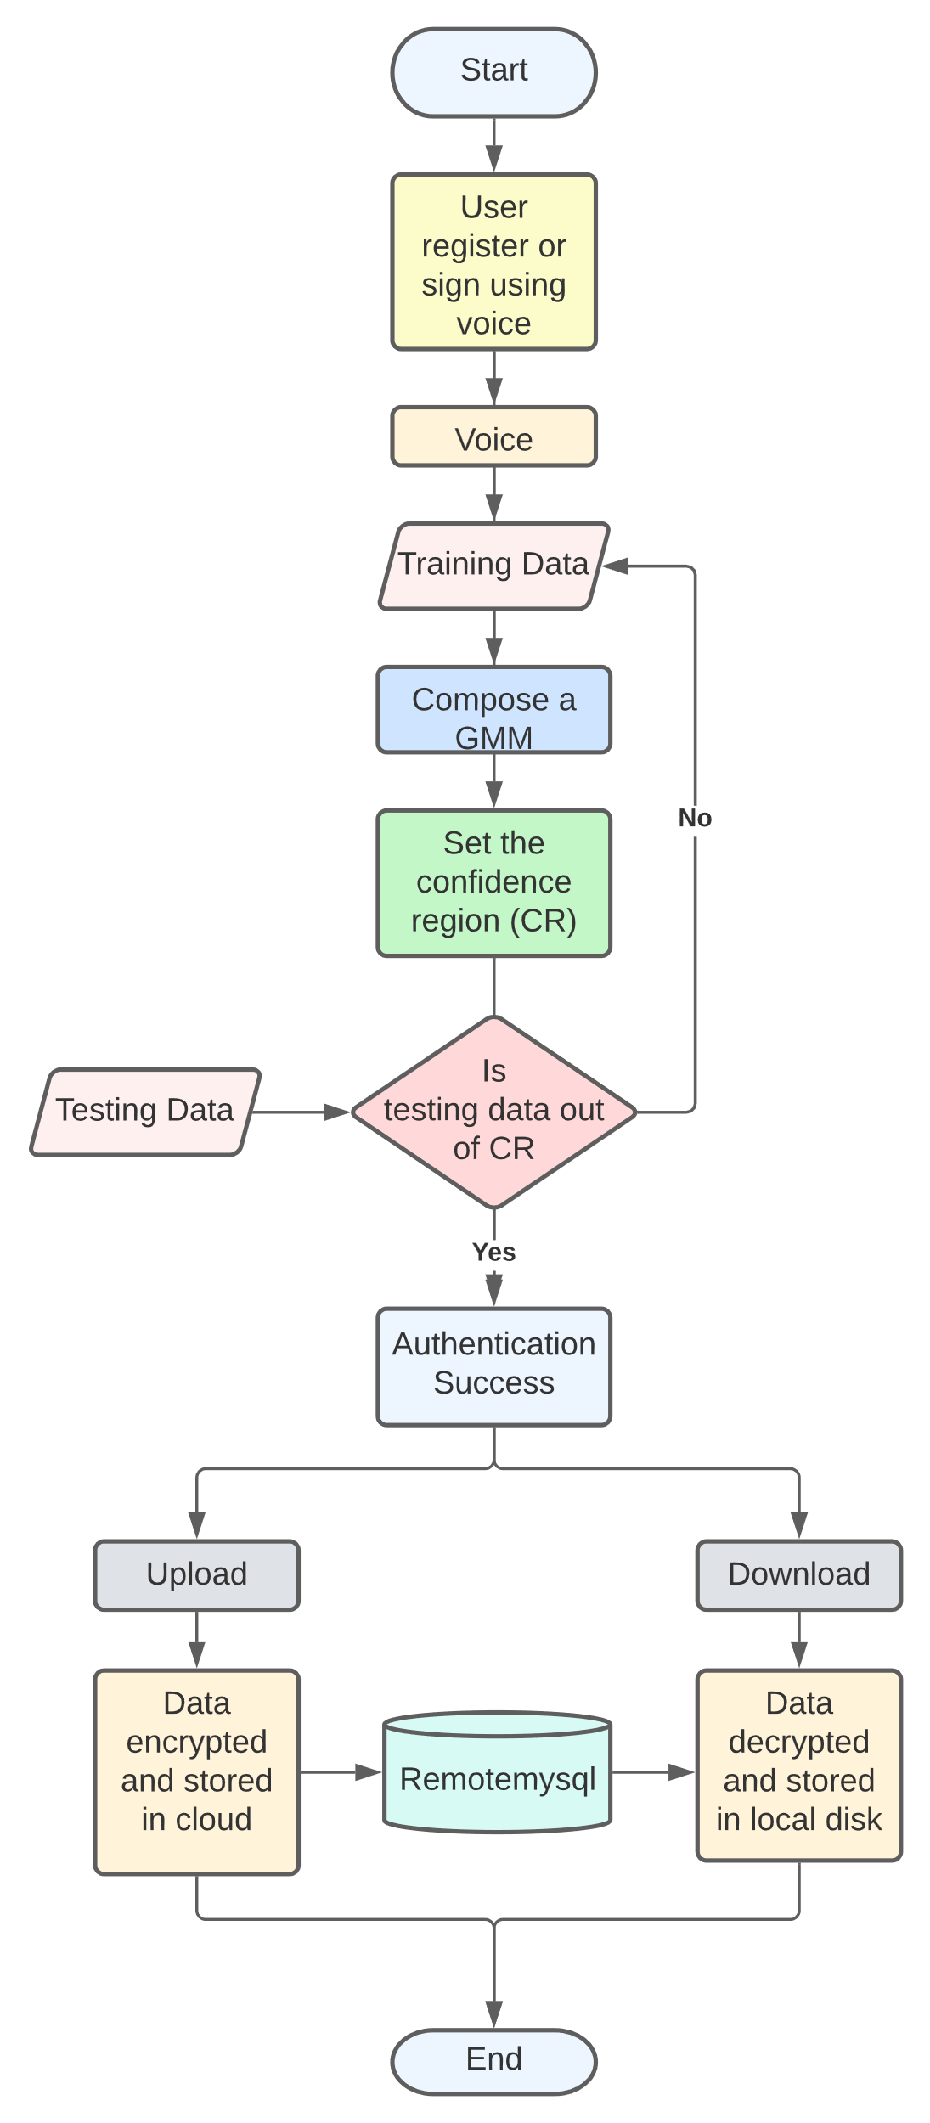
VOICE VAULT
BATCH : B-5
DEPARTMENT OF CSE
ABSTRACT
METHODOLOGY
FLOWCHART
Training data set
Voices of the user are prepared for training in such a way, the voices are captured in .wav file.
Voice Vault is a desktop-based application designed and developed using the python programming language. The tool aims to make cloud storage with proper encryption. The encryption algorithm is self-developed, accurate, and secured. Along with Encrypted cloud storage, we are also providing proper user authentication. User authentication is done using Voice Recognition System. A user’s voice is verified locally against itself, a token is sent to the service provider, and access is granted. We developed a voice recognition system using python & machine learning. It won’t give access to the user until the voice doesn’t match. We used ‘python speech features and pyaudio modules of python for taking voice samples and for preprocessing it, we used the GMM model (Gaussian Mixture Model).
Gaussian Mixture Model
Gaussian Mixture Model (GMM) is used to train the audio files to get the spoken word recognized.
Testing data set
The speaker model with the maximum score is predicted as the identified speaker of the test speech.
Encryption
By uploading an file, it will be converted into a byte array, i.e., data will be in numeric form, and then perform XOR.
Decryption
The encrypted file will again perform XOR-ed to decrypt it.
EXISTING SYSTEM
PROPOSED SYSTEM
TECHNOLOGY STACK
Often many software/tools enable you to prevent other people from viewing, editing, and deleting files and directories. These programs use encryption techniques for security. These tools are designed for protecting files/folders on your local computer. Many such programs can be used to lock directories on a flash drive, external USB drive, internal hard drive, and more. These tools have ads and charge you money for the protection of files.
The proposed tool can be accessed in the real world from any device. There are hacking softwares that can pick up everything entered through the keyboard and store it into a buffer. Hence a password entered through the keyboard can be easily hacked. However, if a password is spoken and the frequencies are considered, there is no software to date that can hack frequencies. The authors present an innovative technique for desktop file hiding. The software-based on this work is capable of locking files such that only the user who has locked them with his spoken password can access them.
Python
RemoteMySql
Cryptography
Gaussian Mixture Model
CONCLUSION
The Voice Vault was designed to hide user important documents and encrypt there files, with voice as key also unlocking them so that they can have access to it. The tool stores all the data in database which can be accessed anytime by the authorized person. The management of all the data will be done by the system, there is no need on arranging data manually. It is concluded that the use of GMM as a statistical model in the speech recognition gives a very high accuracy of recognition (> 70%).
ion.

